Slide 1

PETMON
All in One Tracker for your Pet
Notes:
PETMON easily tracks & manages your dogs health, activity & safety.

Slide 2
ARE YOU A PET OWNER?
then YOUR PET’S health must matter to you

Slide 3
THEN why NOT
TRACK YOUR PET’S ACTIVITIES ?

Slide 4


Slide 5
FEATURES
Track & manage your pet's health, activity & safety
Acquire Activity based data via Location Tracker and Activity Monitor
Monitor health even if you're far away via Pulse and Temperature Monitor
Schedule an appointment with nearby Vet.(Coming Soon)
Notes:
Track & manage your pet's health, activity & safety via RT and Push Notifications

Slide 6
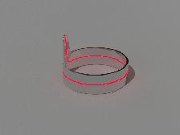

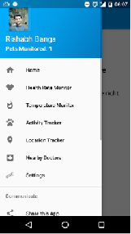
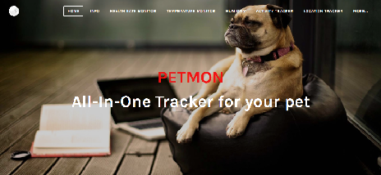
Belt
Cloud
Website
Mobile App

Slide 7

FEATURES - WEBSITE

Slide 8
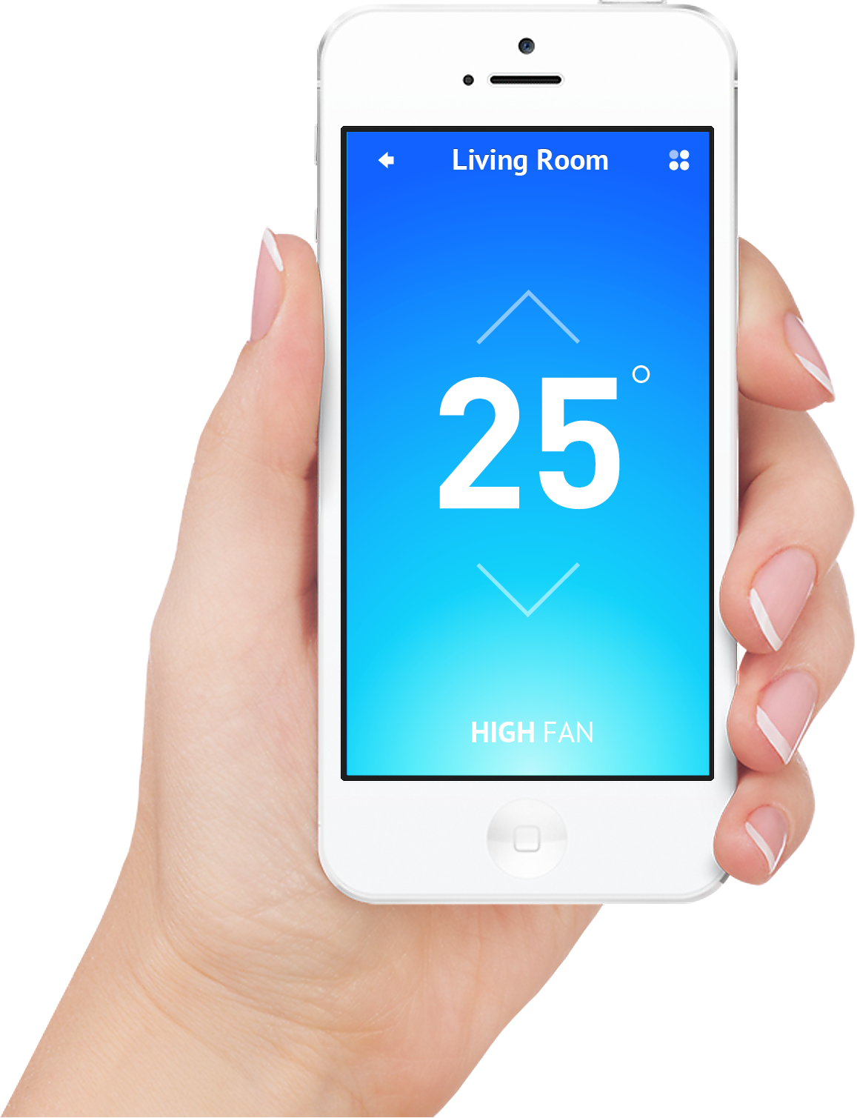

FEATURES – MOBILE APP
 | Now | Today | Yesterday
Pulse Rate | … | … | …
Body Temp | … | … | …
Calories burnt | … | … | …

Slide 9

PETMON
 | Now | Today | Yesterday
Pulse Rate | … | … | …
Body Temperature | … | … | …
Calories Burnt | … | … | …
This Month

Slide 10
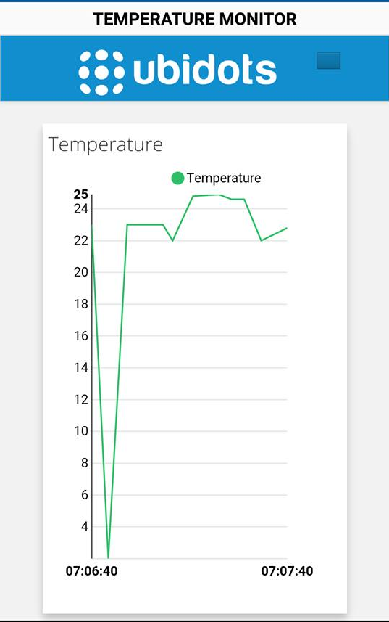

Slide 11
A GLIMPSE OF THE FUTURE
Better, sharper form factor
PETMON in different form factors
PETMON becomes available for babies
Introduce API’s

